Slide 1
Tips and Tricks for Test Automation in Data Quality
Author: Yevhen Nikolin
FEBRUARY 2024

Slide 2
DISCLAMER
Author just shares his opinion but does not pretend to be the source of truth.
Author does not have a strong Test Automation background, so any constructive criticism is welcomed.

Slide 3




Overall Experience
WORK EXPERIENCE
Total working experience in IT: ~10 years
|------------ Quality Assurance: ~3 years
|------------ Data Quality: ~7 years
PROJECTS
Total projects: 10
|------------ Manual Testing: 3
|------------ Data Quality: 7
COMPANIES
NetCracker Feb 2014 – Sep 2016
EPAM Systems Nov 2016 - Today
PROJECT POSITIONS / ROLES
Junior QA Engineer 1
Middle QA Engineer 1
Middle DQ Engineer 1
DB Developer 1
Senior DQ Engineer 4
Lead DQ Engineer 4
CERTIFICATIONS

Slide 4
Agenda
01
Author’s philosophy while working with Data Quality
02
Using templates for automated tests
03
Reference files with objects listing for automated test cases
04
Separation of «coding» from «testing»
05
Analysis of defect priority based on automated metrics
06
Data Quality and Test Automation analytics

Slide 5
Author’s philosophy while working with Data Quality
01

Slide 6
Author’s philosophy while working with Data Quality
Do not overcomplicate the testing environment;
Add new tools / technologies only for dedicated reason but not because it is «cool» and «popular»;
Continuously monitor and mediate higher management’s expectations from Data Quality activities;
Do not blindly follow «best practices»;
Working solution > over-engineered solution by design patterns and best practices.

Slide 7
Using templates for automated tests
02

Slide 8
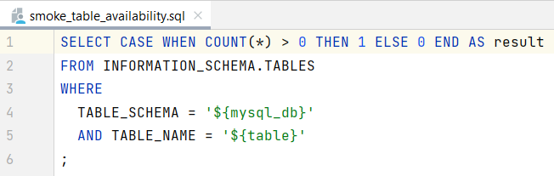
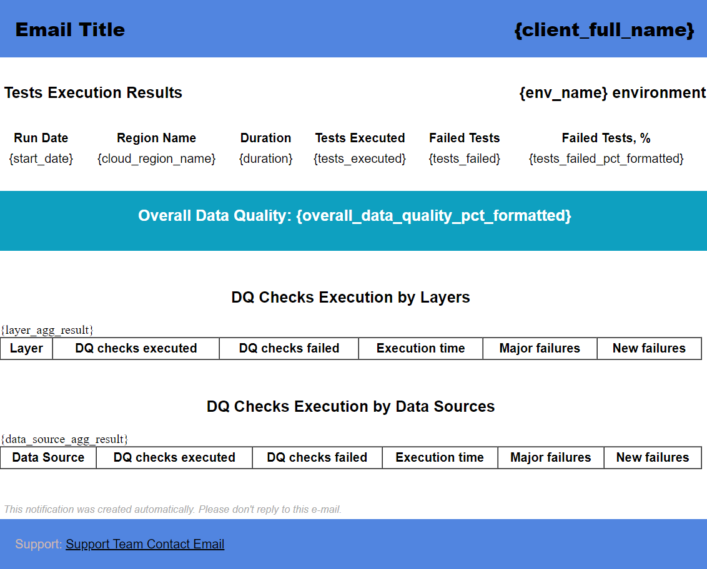
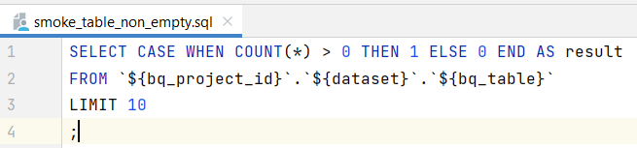
Using templates for automated tests
Examples:

Slide 9
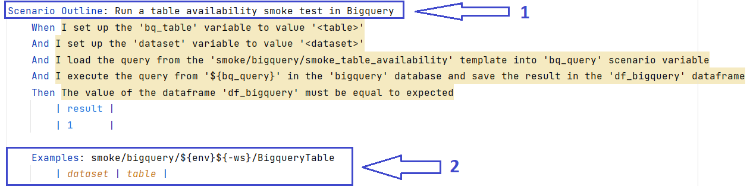
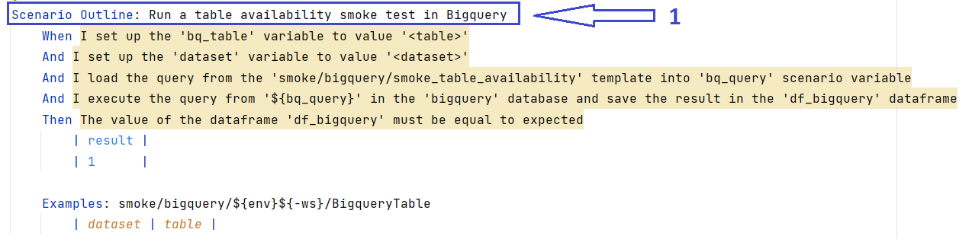
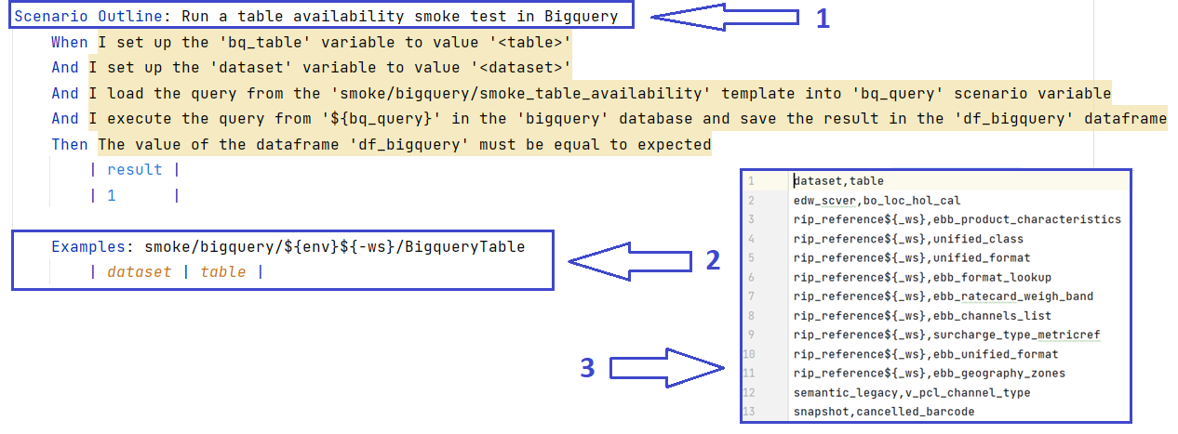
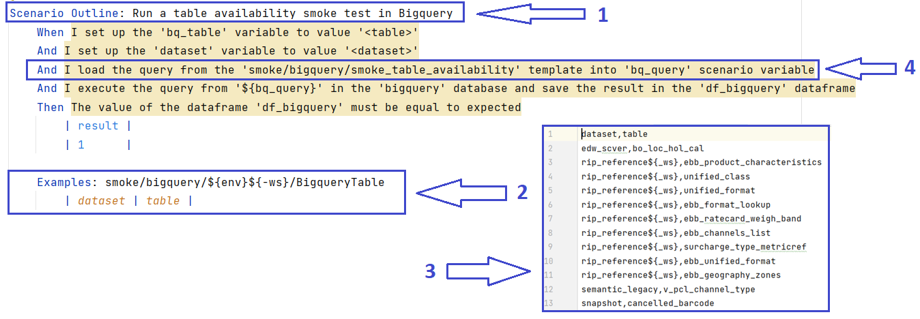
Reference files with objects listing for automated test cases
Examples:

Slide 10
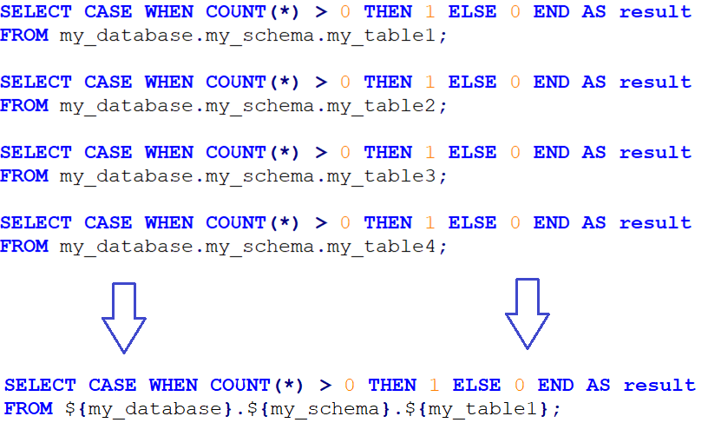
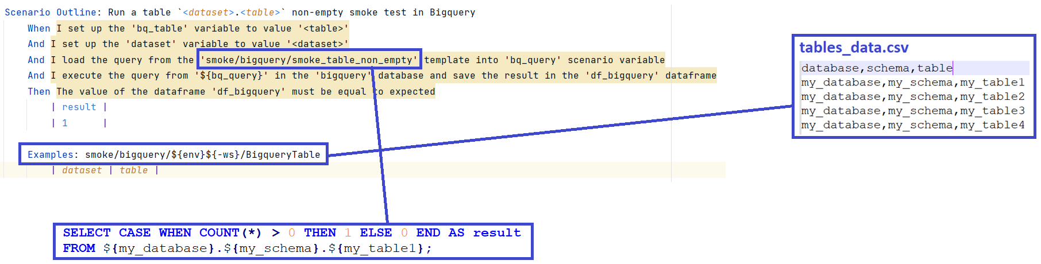
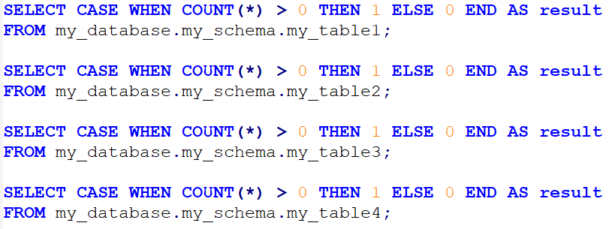
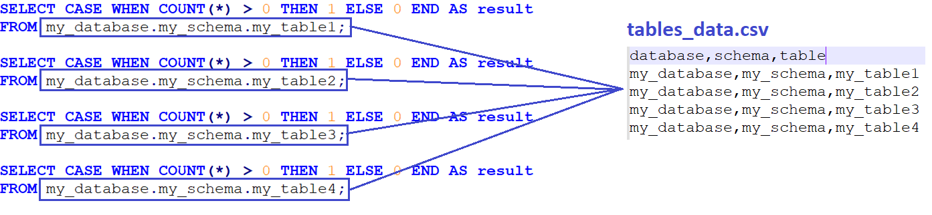
Reference files with objects listing for automated test cases

Slide 11
Separation of «coding» from «testing»
04

Slide 12
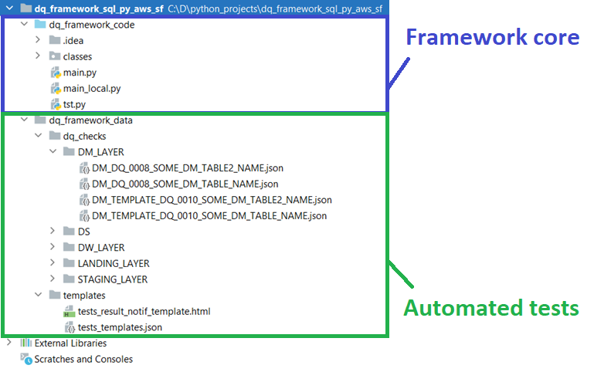
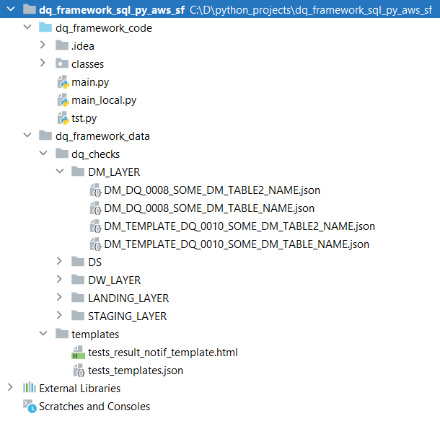
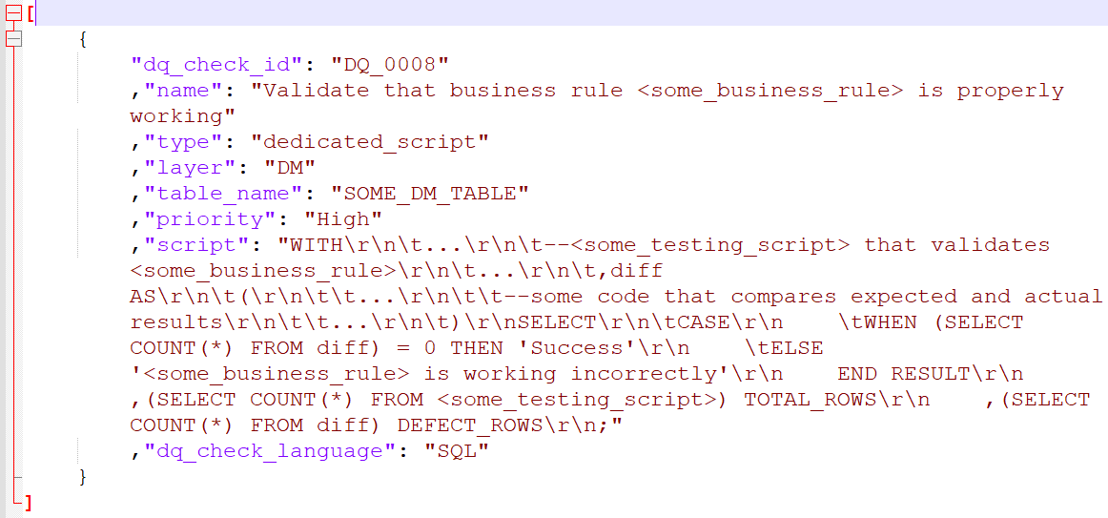
Separation of «coding» from «testing»
Example of one test case

Slide 13
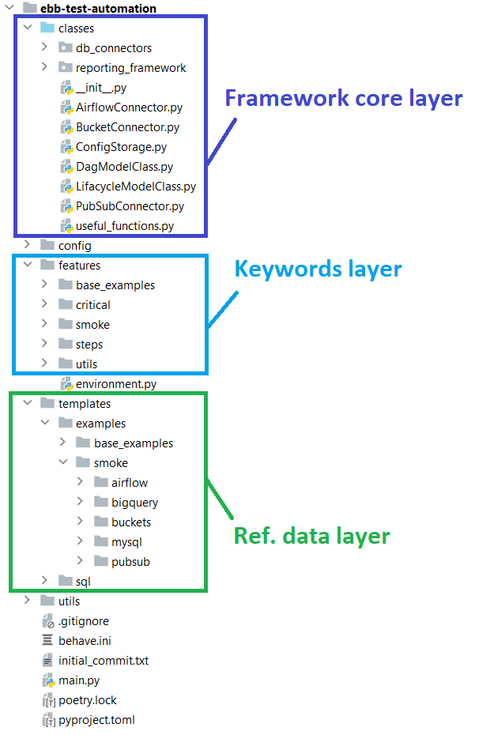
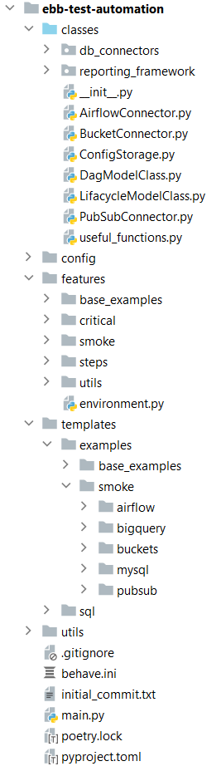
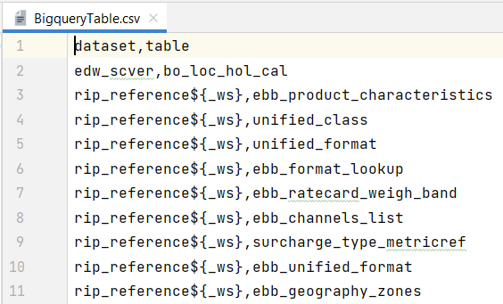
Separation of «coding» from «testing»
Example of ref. data file

Slide 14
Analysis of defect priority based on automated metrics
05

Slide 15
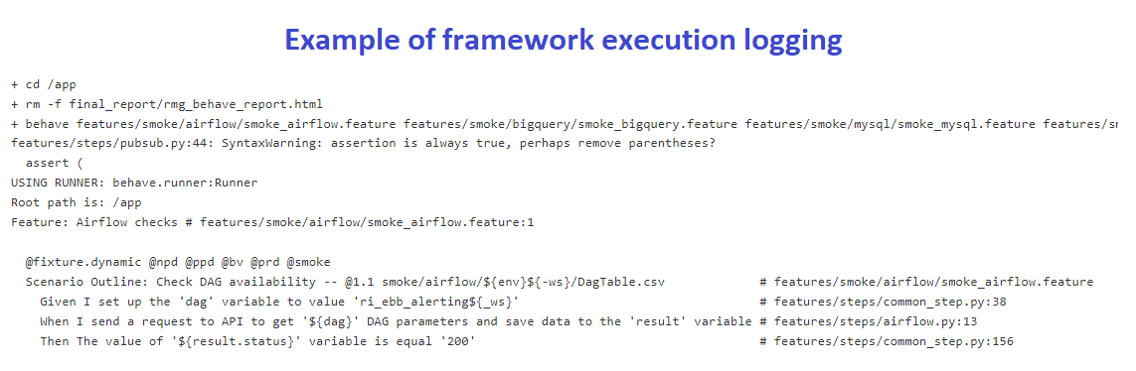
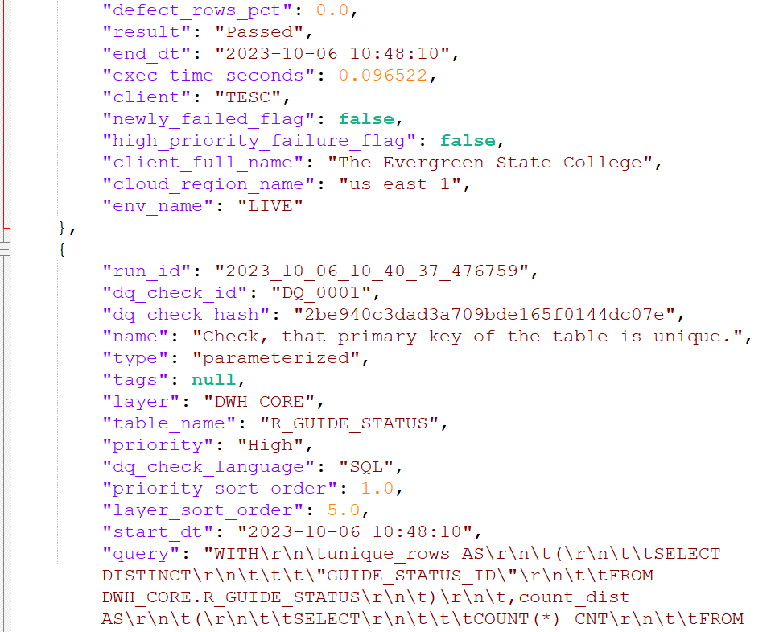
Analysis of defect priority based on automated metrics
Types of logging:
Framework execution logging
Tests execution logging
Example of Tests execution logging

Slide 16
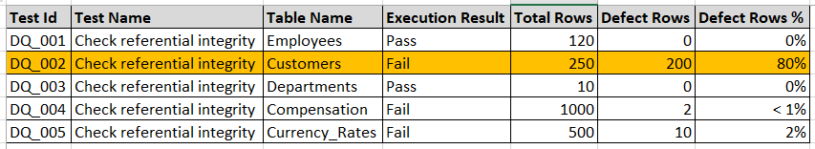
Analysis of defect priority based on automated metrics

Slide 17
Data Quality and Test Automation analytics
06

Slide 18
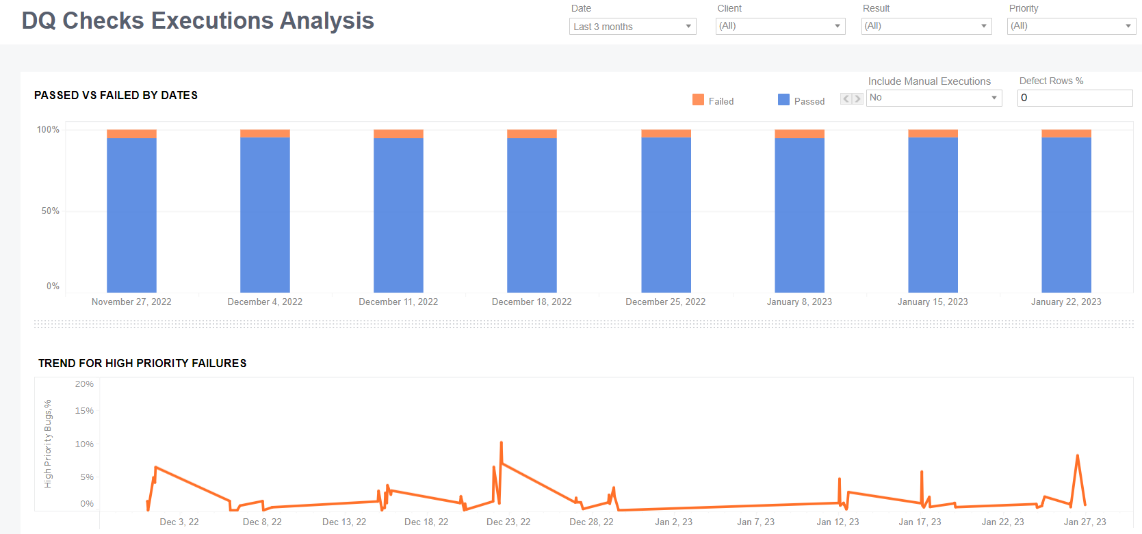
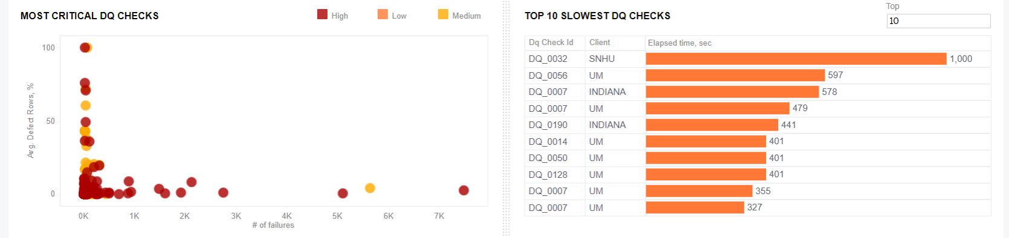
Data Quality and Test Automation analytics
Examples of dashboards:
Log files content

Slide 19

Thank you!
Yevhen Nikolin
Lead Data Quality Engineer

